Slide 1

Advanced Course in CGE Modeling Using IFPRI’s Dynamic CGE and Microsimulation Models

Slide 2
Overview _{(Parts 8-10)}
Recap Foundation Course
IFPRI Standard CGE Model
Microsoft-Excel® Interface
8. Introduction to GAMS
Coding a Multi-Market Model
Walkthrough Standard CGE Model Code
9. Advanced Static Modeling
Revisiting elasticities and closures
Using GDX Files
Complicated Scenarios

Slide 3
Overview
10. Introduction to Dynamic Modeling
Recursive dynamics
Dynamic model files
Establishing a baseline
Designing simulations
11. Dynamic Model Exercises
12. Microsimulation Module
Poverty, hunger and diet metrics
Top-down microsimulation module

Slide 4
Part 8 Introduction to GAMS Coding a Multi-Market Model

Slide 5
What is GAMS?
General Algebraic Modeling System
Mathematical programming environment
(not for statistics like Stata, SPSS)
Solves systems of equations
(easy to do vector or matrix calculations)
Solves problems that involve optimization
(like maximize income, minimize costs, etc.)

Slide 6
Learning GAMS
Exercise 1
Simple economic model (demand-supply or multi-market model)
Exercise 2
Adding in income-effects (income elasticities)
Exercise 3
Adding in substitution-effects (cross-price elasticities)
Exercise 3
Adding exogenous imports to supply

Slide 7
Simplest Demand-Supply Model
Price (P)
Supply curve (S)
e₁
QS = f(P)
P₁
e₀
P₀
Demand curve (D)
QD = f(P)
Q₁
Q₀ (QD=QS)
Quantity (Q)

Slide 8
Specifying the Demand Curve
Price (P)
Demand curve (D)
QD = f(P)
Slope
d₁= ∆QD/∆P
∆P
We assume f is linear…
QD = d₀ - d₁P
∆QD
∆P
∆QD
D
Intercept
d₀
Quantity (Q)

Slide 9
Specifying the Supply Curve
Price (P)
Supply curve (S)
QS = f(P)
QS = s₀ + s₁P
S
∆P
∆QS
s₁= ∆QS/∆P
s₀
Quantity (Q)

Slide 10
Mathematical Equations
Demand curve
Supply curve
Equilibrium
where c is a set of commodities
So, if we have two commodities (e.g., agricultural and industrial goods), then we have two demand, supply and equilibrium equations (one for each commodity)

Slide 11
Breaking Up the Problem in GAMS
Demand curve
Supply curve
Equilibrium
Sets indices (agricultural goods, industrial goods)
Variables endogenous variables (price, quantity demand/supplied)
Parameters exogenous variables (slopes, intercepts)
Equations structural relationships between variables and parameters
Model collection of equations

Slide 12
Exercise 1 | Simple Model
Objective
Learn the basic syntax and structure of GAMS
Details
Code is provided specifying the demand-supply model.
Two commodities (agriculture, industry).
Tasks
We’ll go through the code together and discuss how each of the components are specified
Then we’ll impose a supply-side shock (e.g., a decline in agricultural supply due to poor rains) and assess its impact on quantity demanded/supplied and prices.

Slide 13
Exercise 1 | Shocking the Model
Task
Simulate an 20% decrease in the supply intercept for agriculture.
Compare results with initial values.
Solution: Add the following lines of text before the ‘display’ command at the end of the code file…
s0('agr') = s0('agr') * 0.8;
solve MMMOD using MCP;
Note
We will use the same shock for all the other exercises.

Slide 14
Exercise 2 | Income Elasticities
We know that demand doesn’t just depend on prices. It also depends on incomes.
We also know that incomes depend on production.
So, in this exercise we do two things:
1. Calculate incomes based on the level of supply
2. Adjust demand according to the level of incomes

Slide 15
Exercise 2 | Income Elasticities
P
S₂
Step 1: supply curve shifts to the left (shock)
increase in price, reduction in quantity supplied
decline in income
p₁
S₁
p₂
p₀
D₁
Step 2: demand curve shifts to the left (falling income)
quantity falls further, but price increases slightly
q₀
D₂
Q
Y
Income elasticity of demand
Y= f(Q)
y₀
Y now affects the quantity demanded
y₁
y₂
q₂
q₁
q₀
Q
Income (Y) is the wage (w) generated per unit of production
Wage rate

Slide 16
Exercise 2 | Income Elasticities
Objective
Learn how to introduce new equations to the model and use the summation function
Details
Introduce income elasticities into the model from exercise 1.
Tasks
Add in the new income equation to the model using the equations in the hand-out
There is one new equation (income), one new variable (Y), three new parameters (Y0, w and d2), and one additional term in the demand equation (d2Y)

Slide 17
Exercise 3 | Cross-Price Elasticities
We’ve included the effect that changes in incomes have on quantity demanded (i.e., income-effects)
However, we also know that the changes other goods’ prices make our good more/less attractive to consumers
Therefore, we also need to include substitution-effects (i.e., cross-price elasticities of demand)
Cross-price or substitution effects: This is where the price of one good affects the demand for other goods

Slide 18
Exercise 3 | Cross-Price Elasticities
Agriculture
Step 1: agricultural supply curve shifts to the left
increase in agric. price, reduction in agric. quantity
decline in income
P
S₁
S₀
D₀
Step 2: industrial demand curve shifts to the left (cross-price substitution-effect)
increase in industrial price and quantity
Q
Industry
P
S₀
There is a cross-price effect between every pair of commodities. Therefore, in adjusting quantity demanded for our commodity (c) we must sum the cross-price effects from other commodities (c’)
D₁
D₀
Q

Slide 19
Exercise 3 | Cross-Price Elasticities
Objective
Learn how to use aliases and mappings between elements in sets, and enter data using tables
Details
Introduce cross-price elasticities into the model from exercise 2.
Tasks
There is one new parameter (d3), one new table (MAP), and one additional term in the demand equation (Σd3P)
Mappings are true/false (1/0) matrices linking two sets together (e.g., the identity matrix). We will enter this data using a ‘table’, although usually this is done using sets.

Slide 20
Exercise 4 | Exogenous Imports
So far, we’ve assumed that all goods are produced inside the country (i.e., domestic demand equals domestic supply in equilibrium)
However, we know that some domestic demand is supplied by imports
So, in this exercise we allow imported goods
However, we don’t do this in a complicated way (no substitution between domestic and imported goods – imports are determined exogenously)

Slide 21
Exercise 4 | Exogenous Imports
M
Imports are exogenous (i.e., the are not a function of price – do not change when price changes)
P
S₁
S₀
Step 1: determine domestic market equilibrium quantity (Q’)
P’
P₁
P₀
Step 2: add in import quantity (QM)
D
QM
QM
QM
Q’
Q’
Q₁
Q₀
Q
Only the market equilibrium equation must change – now imports are added to domestic supply

Slide 22
Exercise 4 | Exogenous Imports
Objective
Learn how to fix variables
Details
Introduce exogenous imports into the model from exercise 3.
Tasks
There is one new parameter (QM0) and one new variable (QM), but the variable needs to be fixed…
Rather than QM.L(C) = QM0(C)
We use QM.FX(C) = QM0(C)
This makes the variable function like a parameter

Slide 23
Part 8 Introduction to GAMS Walkthrough Standard CGE Model Code

Slide 24
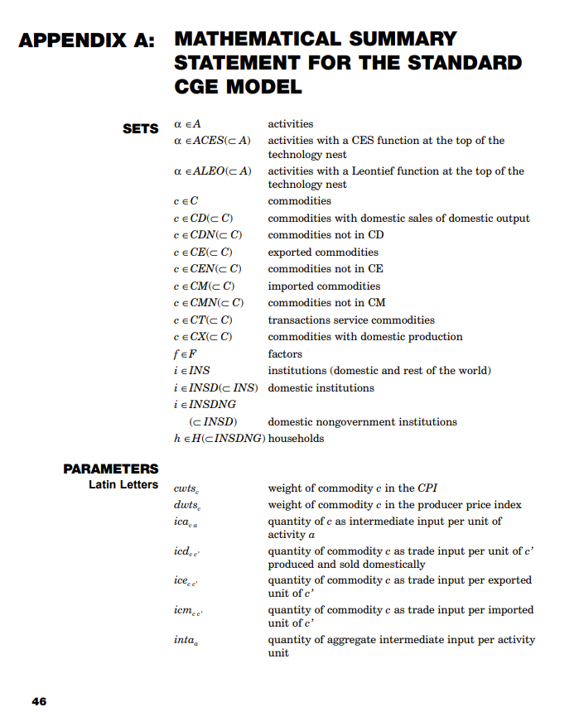
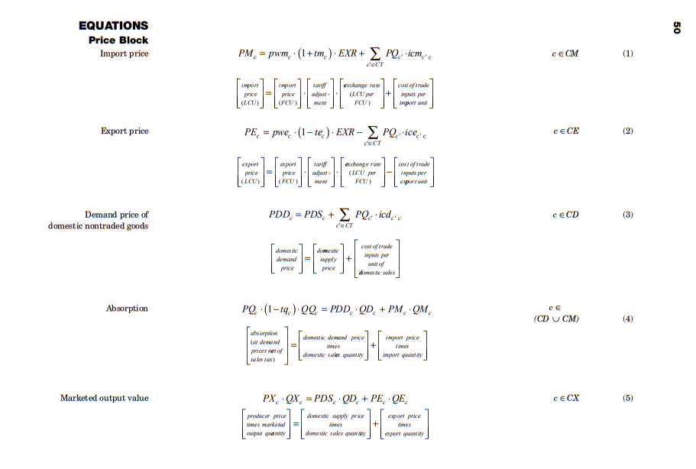
Tasks
Revisit standard model’s equations
Identify sets, parameters, variables, equations and models
Find this these the “handouts” folder (CGE model equations)
Walk through standard model’s GAMS code
Understand the lay out of the model
Look for types of code you recognize from the multi-market exercises

Slide 25
Standard Model Equations
Equations are separated into “blocks”
Prices
Import and export prices
Domestic price build-up (producer to consumer)
Price indices
Production and trade
Import demand and export supply
Domestic supply
Institutions
Factor incomes
Household incomes and demand
Government revenues and expenditures
System constraints
Market equilibrium and macro closures

Slide 26
Supply Chains | From Part 5
 | A | C | F | D | W | TOT
A
C
F
D
W
TOT
A = Activities
C = Commodities
F = Factors
D = Final demand
W = Rest of world
Equilibrium: Total commodity supply must equal total demand
(mediated by prices changes)
Factory
Activities combine factor and intermediate inputs to produce activity output
Warehouse
Warehouse sorts outputs from activities into bundles of like commodities
Trade
Commodity output is traded in export or domestic markets – latter is combined with imports
Supermarket
Composite supply is either sold to final demanders or to producers as inputs
Labor
Land
Value-added
Imports
×
×
=
Households
Capital
Activity output
Commodity output
Domestic sales
Composite supply
Government
=
=
Input 1
×
=
Investment
Input 2
Intermediates
Main output
Exports
=
=
Intermediate
Input N
By-product
×
× Price-driven substitution
= No substitution
Others’ output

Slide 27
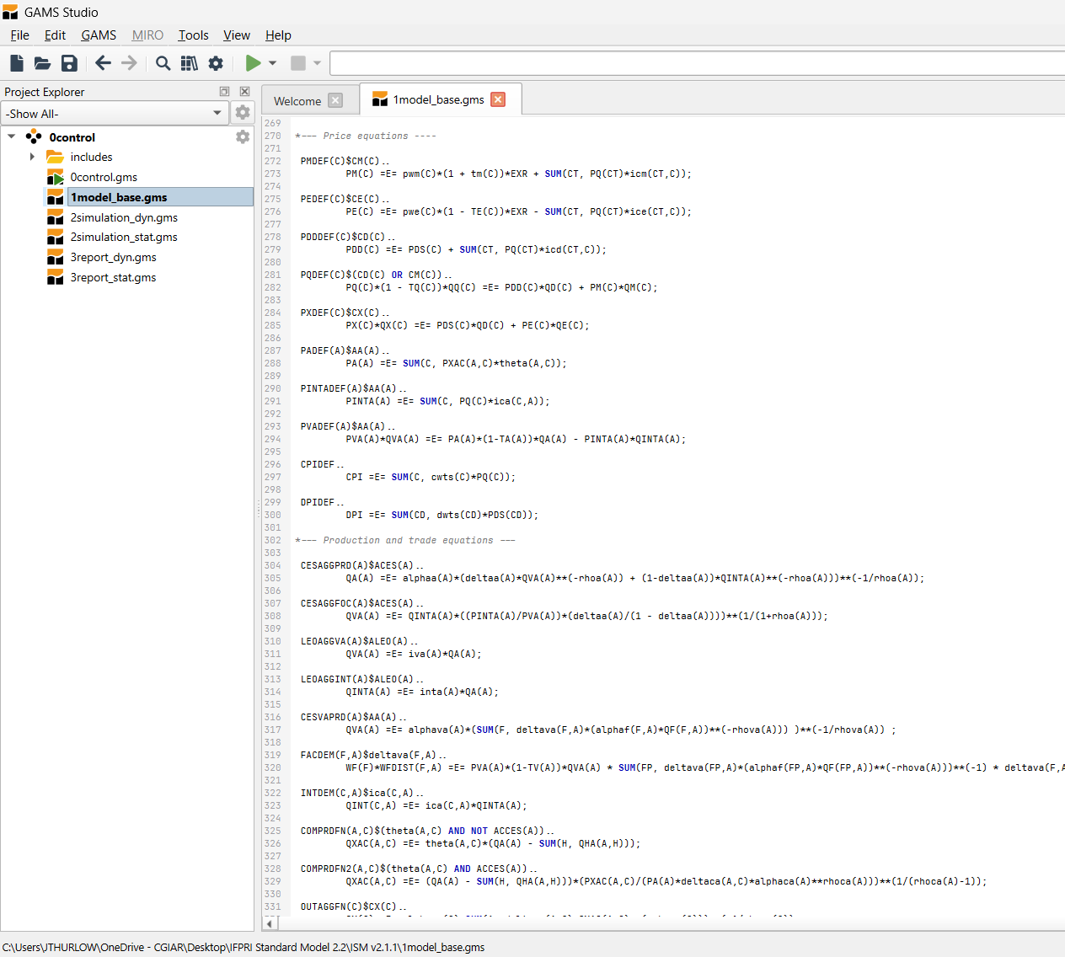
Model’s GAMS Code
Model Control
0control.gms
Model Data
basemod.xlsx
Model Code
1model.gms
Simulation Data
statsim.xlsx
Simulation Code
2simulation_static.gms
Results File
statrep.xlsx

Slide 28
Standard Model’s GAMS Code | 1model.gms
Base model file is separated into 7 sections:
1. Declarations
Sets
Parameters
Variables
2. Model definition
Prices
Production and trade
Institutions
System constraints
3. Model declaration
Model file is separated into sections:
4. Country data
base_data.inc
base_diagnostic.inc
5. Model calibration
base_calibration.inc
6. Model solve
7. Base model reporting
base_report.inc
Declaration
Give the parameter or variable a name
Definition
Give the parameter or variable a value

Slide 29
Part 9 Advanced Static Modeling Revisiting Elasticities and Closures

Slide 30
Overview
Sensitivity analysis
Trade elasticities
Exercise 1: Tariff liberalization (high/low elasticities)
Factor substitution elasticities + factor market closures
Exercise 2: Agricultural productivity (high/low elasticities + fixed/flexible land + unemployed labor)
Macro closures
Exercise 3: Foreign capital outflows (savings-investment + uniform/scaled savings rates)
Exercise 4: Cash transfers (fixed/flexible government savings + uniform/scaled tax rates)

Slide 31
Elasticities | Functional Forms
Cobb-Douglas (CD)
Constant expenditure shares
$$Q=α∙L^{β}∙K^{1−β}$$
$$w∙L=β∙P∙Q$$
$$r∙K=\left(1−β\right)∙P∙Q$$
Constant Elasticity of Substitution (CES)
Shares relative to prices
Leontief
Fixed quantity ratios
Labor employment (L)
Labor employment (L)
r*/w
r/w
Capital employment (K)
Capital employment (K)

Slide 32
Exercise 1 | Tariff Liberalization
Shock
Eliminate all tariffs (i.e., -100%)
Two sets of closures
Sim1: Full employment, savings-driven investment, deficit financed (fixed savings rates, flexible investment, flexible government savings)
Sim2: Full employment, savings-driven investment, tax financed (fixed savings rates, flexible investment, flexible direct tax rates)
Government
Recurrent fiscal deficit (savings) equals total revenues (taxes and grants) less total expenditures (consumption and transfers)
Fix two
Tax rates
Consumption
Public savings
Direct taxes
+
Indirect taxes
+
Grants
=
Consumption
+
Transfers
+
Public saving
Savings – Investment
Total supply of loanable funds (savings) must equal total investment demand
Fix one
Savings rates
Investment
Private saving
+
Public saving
+
Foreign saving
=
Investment

Slide 33
Exercise 1 | Walkthrough
Macro
↓Tariffs → ↑Imports → Real exchange rate depreciation → ↑Exports
↓Tariffs → ↓Consumer prices → ↑Private consumption
↓Tariffs = Revenue shortfall → ↓Public savings OR ↑Tax rates
↓Public savings → ↓Investment
↑Tax rates → Smaller ↑private consumption
Trade (+ Base)
↓Tariffs → ↑Import-intensive commodities
Sector
↓Tariffs → ↓GDP for import-competing sectors
Households
↑Private consumption (smaller with ↑private savings)
↑Tax rates → ↓Consumption for high-income urban households

Slide 34
Exercise 1 | Files in the Folder
Change elasticities in basemod.xlsx
Model Control
0control.gms
Model Data
basemod.xlsx
Model Code
1model.gms
Simulation Data
statsim.xlsx
Simulation Code
2simulation_static.gms
Results File
statrep.xlsx

Slide 35
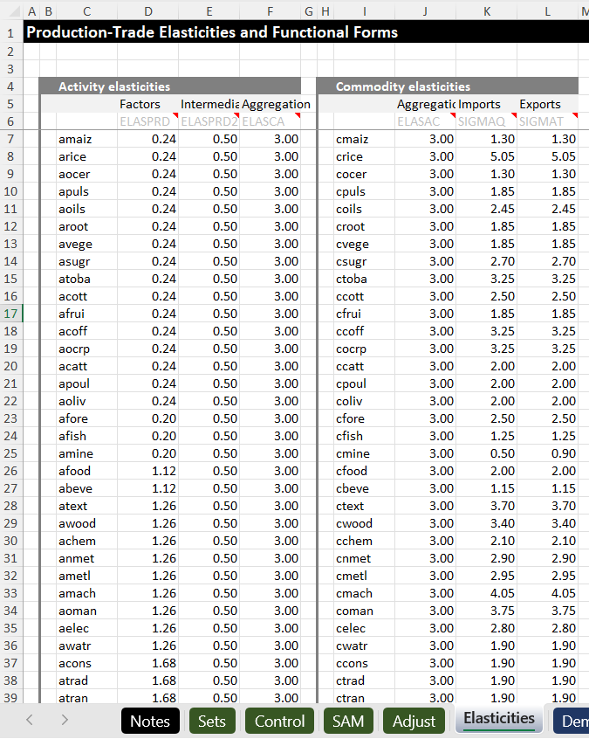
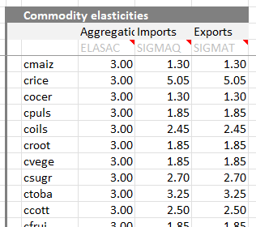
Exercise 1 | Changing Import Elasticities
basemod.xlsx
Tasks
Save a copy of your statrep.xlsx file
Set all import trade elasticities to 0.5
Rerun model and compare new and old output files
Save file
Elasticities
statsim.xlsx | Elasticities

Slide 36
Exercise 1 | Questions
Compare the old and new output files:
How did lowering elasticities change macroeconomic outcomes?
Which sectors are hurt or benefits the most under each set of elasticities?
How was the distribution of impacts on household consumption affected?

Slide 37
Exercise 1 | Answers
Compare the old and new output files:
How did lowering elasticities change macroeconomic outcomes?
Same change in import taxes / GDP ratio
Smaller import response
Exchange rate appreciates rather than depreciates (export effect now dominates)
Small decline in household consumption
Which sectors are hurt or benefits the most under each set of elasticities?
Clothing used to benefit the most, and still does with the lower elasticities (high tariffs)
Metals used to be worst affected, but now it is cut flowers (exports hurt by appreciation)
How was the distribution of impacts on household consumption affected?
Similar change for Q5 households (due to same deficit and tax increase)
Smaller increase for Q1-Q4 (more output is directed to exports rather than consumption)

Slide 38
Factor Market Closures and Elasticities
Equilibrium: Total factor supply must equal sum of sectoral factor demand (determined by “closure rules”)
Factory
Workforce
=
Labor
+
Labor
+
Labor
Factor substitution elasticities
How easily can producers substitute between factors in response to changes in relative factor prices?
Land availability
=
Land
+
Land
+
Land
Value-added
×
Capital supply
=
Capital
+
Capital
+
Capital
× Price-driven substitution
Factor market closure
Adjust total factor supply?
Adjust wages?
Wages
Wages
Option 1
Full employment
Option 2
Unemployment
Employment
Employment

Slide 39
Exercise 2 | Agricultural Productivity
Shock
Increase paddy rice TFP by 50% (just in agriculture)
Three different sets of closures
[
Sim1: Labor/land full employment, capital sector-specific, savings-driven investment, deficit financed
Sim2: Labor full employment, capital/land sector-specific, savings-driven investment, deficit financed
Sim3: Urban labor full employment, rural labor unemployment, capital/land sector-specific, savings-driven investment, deficit financed
Workforce
=
Labor
+
Labor
+
Labor
Base factor substitution elasticities
Agriculture = 0.5
Non-agriculture = 2.0
Land availability
=
Land
+
Land
+
Land
Value-added
×
Capital supply
=
Capital
+
Capital
+
Capital
× Price-driven substitution

Slide 40
Exercise 2 | Questions
Look at the results:
What happens to rice production/trade quantities and prices? How do closures affect these?
What happens to production of other crops?
What happens to rural employment and land rents?
Which households benefit the most from rice productivity gains?

Slide 41
Exercise 2 | Answers
Look at the results:
What happens to rice production/trade quantities and prices? How do closures affect these?
Rice production increases by >30%, rice prices fall by >30%, and milled rice imports fall by >30%
Production increase and price/trade declines are larger with sector-specific cropland
What happens to production of other crops?
Production increases for most non-rice crops when land is flexible, but falls when it is fixed
Cut flowers, jute and nut production expand strongly, but only when land is flexible
What happens to rural employment and land rents?
Rural employment increases, but land rents fall considerably, esp. when land is fixed
[
Which households benefit the most from rice productivity gains?
Urban and rural nonfarm households are the main beneficiaries
Rural farmers are adversely affected, esp. when land is fixed (due to falling rice prices)
Having unemployed rural labor doesn’t do enough to reverse declines for rural farmers in Q2-Q4

Slide 42
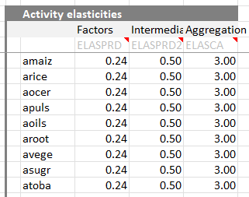
Exercise 2 | Changing Factor Substitution Elasticities
basemod.xlsx
Tasks
Save a copy of your statrep.xlsx file
Set agricultural factor substitution elasticities to 1.5
Rerun model and compare new and old output files
Save file
Elasticities
statsim.xlsx | Elasticities

Slide 43
Exercise 2 | Questions
Compare the old and new output files:
What happens to rice production/trade quantities and prices now that elasticity are larger?
What happens to production of other crops?
What happens to rural labor employment and land rents when elasticities are increased?
[
Which households benefit the most from rice productivity gains?

Slide 44
Exercise 2 | Answers
Compare the old and new output files:
What happens to rice production/trade quantities and prices now that elasticity are larger?
Rice production increases and price/trade declines are now smaller (rice sector can shed workers)
Gaps between “closure scenarios” are now slightly smaller
What happens to production of other crops?
Cut flowers now grows very fast when land is flexible (can more easily absorb displaced workers)
What happens to rural labor employment and land rents when elasticities are increased?
Increase in rural labor employment is lower with higher elasticities (more workers released from rice)
Land rents were declining a lot, but decline is now smaller
[
Which households benefit the most from rice productivity gains?
Rural farm households’ consumption outcomes are much better with higher elasticities (because land returns don’t fall as much)

Slide 45
Exercise 3 | Foreign Capital Outflows
Shock
Decrease foreign capital outflows by 50%
Four sets of closures
Sim1: Full employment, savings-driven investment (fixed savings rates, flexible investment)
Sim2: Full employment, investment-driven savings (fixed investment, flexible savings rates, scaled MPS adjustment)
Sim3: Unemployment, investment-driven savings (fixed wage rate, flexible labor supply , scaled MPS adjustment)
Sim4: Unemployment, investment-driven savings (fixed wage rate, flexible labor supply , uniform MPS adjustment)
Current account
Total inflow of foreign exchange (exports, grants and remittances) must equal total outflows (imports)
Fix one
Exchange rate
Foreign savings
Exports
+
Grants
+
Remittances
+
Foreign saving
=
Imports
Savings – Investment
Total supply of loanable funds (savings) must equal total investment demand
Fix one
Savings rates
Investment
Private saving
+
Public saving
+
Foreign saving
=
Investment

Slide 46
Exercise 3 | Walkthrough
Macro
↓Foreign savings = Exchange shortage → Real exchange rate depreciation → ↑Exports & ↓Imports
↓Foreign savings = ↓Loanable funds → ↓Investment OR ↑Private savings
↑Private savings → ↓Private consumption
Trade (+ Base)
Depreciation → ↑Export-oriented products (e.g., flowers) & ↓Import-intensive products (e.g., machinery)
Sector
↓Investment → ↓Construction
↓Private consumption → ↓Food
Factors
↓Wages OR ↑↓Employment (larger ↓wage with ↓construction, which is capital-intensive)
Households
↓Private consumption (larger with ↑private savings & unemployment)
High income households are worst-affected

Slide 47
Exercise 4 | Cash Transfers
Shock
Double household transfers from government
Four sets of closures
Sim1: Full employment, savings-driven investment (fixed savings rates, flexible investment)
Sim2: Full employment, savings-driven investment (fixed investment, flexible savings rates, scaled tax rate adjustment)
Sim3: Full employment, savings-driven investment (fixed wage rate, flexible labor supply , uniform tax rate adjustment)
Government
Recurrent fiscal deficit (savings) equals total revenues (taxes and grants) less total expenditures (consumption and transfers)
Fix two
Tax rates
Consumption
Public savings
Direct taxes
+
Indirect taxes
+
Grants
=
Consumption
+
Transfers
+
Public saving
Savings – Investment
Total supply of loanable funds (savings) must equal total investment demand
Fix one
Savings rates
Investment
Private saving
+
Public saving
+
Foreign saving
=
Investment

Slide 48
Part 9 Advanced Static Modeling Complicated Scenarios

Slide 49
Overview
Climate shocks and social transfers
Exercise 5: Climate shocks (short vs. long-run impacts)
Global energy shock
Exercise 6: Fuel price spike (short vs. long-run impacts)
Macro closures
Exercise 7: Foreign capital outflows (foreign inflows + impact on capital supplies)
Short-run
Limited ability to respond to shocks by changing resource allocations and changing behavior
Long-run
Greater ability to reallocate resources and change behavior to limit impacts of shocks

Slide 50
Exercise 5 | Climate Shocks
Shock
Reduce productivity of all crops, livestock and fisheries by 20%
Increase cash transfers to offset impacts on poorer households
Increase foreign payments to government
Closures
Labor full employment
Capital sector-specific
Savings-driven investment
Exchange rate flexible
 | Fixed land by crop | Flexible land across crops
No transfers | Sim 1 (sudden shock, no response) | Sim 2 (long-term change, no response)
Deficit financed transfers | Sim 3 (sudden shock, short-term response)
Tax financed transfers | Sim 4 (sudden shock, long-term response)
Foreign financed transfers | Sim 5 (sudden shock, long-term response)
Four simulations

Slide 51
Exercise 6 | Fuel Prices
Shock
Increase world petroleum and crude oil prices by 50%
Subsidize petroleum prices to offset household impacts
Closures
Labor full employment
Capital sector-specific
Savings-driven investment
Flexible government savings
 | Flexible foreign savings | Flexible exchange rate
No energy subsidies | Sim 1 (sudden shock, no adjustment) | Sim 2 (sudden shock, some adjustment)
With energy subsidies | Sim 3 (sudden shock, short-term response)
Three simulations

Slide 52
Exercise 7 | Capital Outflows
Shock
Increase foreign capital outflows by 500%
Reduce capital supply by 3%
Closures
Labor full employment
Land fixed by sector
Capital fully employed
Flexible government savings
 | Flexible Savings rates
No change in capital supply | Sim 1 (short-run shock)
Reduced capital supply | Sim 2 (longer-run shock)
Two
simulations

Slide 53
Part 10 Introduction to Dynamic Modeling Recursive dynamics

Slide 54
Recursive Dynamics | Counterfactual Analysis
CGE model is a laboratory for experimenting with different policies and shocks[
Counterfactual analysis measures outcomes with (before) and without (after) shock or intervention
Can be used as either static or dynamic model
Choice depends on the policy or shock being analyzed (e.g., impacts of a rapid onset shock vs. designing long-term investment strategies)
In a static model:
With policy
Impact of policy
In a dynamic model:
Without policy
(baseline)
Base year
Final year

Slide 55
Recursive Dynamics | Annual Updates
CGE model is solved annually with inter-annual updates to key parameters
Endogenous updates depend on results from previous years
Exogenous updates are fixed over time
Endogenous Updating
Exogenous Updating
Capital accumulation rate
Depends on previous year’s investment levels, which are themselves endogenous (i.e., of national incomes and savings rates)
Capital allocation by sector
Depends on past investment allocations and previous year’s relative profits across sectors
Population & labor supply
Rural & urban projections from UNDESA or official data
Labor adjusted using labor force survey trends
Land supply & agric. productivity
Based on FAO or official trends (total cultivated area)
Macroeconomy
Baseline assumes trends from previous decade continues (incl. GDP growth by sector, absorption structure, trade balance, remittances/FDI, etc.)

Slide 56
Recursive Dynamics | Endogenous Capital Accumulation
Capital accumulation
Factor costs
Wages & rents
Factor Markets
Domestic private savings
TFP growth
Direct taxes
Public savings
Labor supply
Firms
Households
Government
Savings & Investment
Intermediate demand
Social transfers
Indirect taxes
Product Markets
Sales
Private consumption
Public consumption
Investment demand
Public Consumption
Investment demand
Imports
Foreign Markets
Foreign savings or capital inflows
Exports
Foreign savings or capital inflows

Slide 57
Recursive Dynamics | Simulation Structure
Step 2: Apply shocks to the baseline
Static models have base years, but dynamic models have baseline scenarios
GDP
Model must solve each year within each scenario (i.e., it loops over sims and years)
Simulation
Baseline scenario
Step 1: Establish a baseline scenario
Base year
Year 2
Year 3
Year 4
Year 5
Year 6

Slide 58
Recursive Dynamics | Capital Accumulation
Saving
Previous period GDP
GDP
+
Taxes
=
C
+
I
+
G
+
X
-
M
Current period capital
New capital
Previous period capital
+
Previous capital
-
Depreciation of capital
=
Installed capital
Current available capital is equal the new capital from previous period investment, plus the old capital that remains after depreciation
=
Available capital

Slide 59
Recursive Dynamics | Capital Allocation
Allocation
New capital must be allocated to sectors
New capital
Profit rate differentials
Used to allocate new capital
Differential = (WF x WFDIST) / WF
Activity 1
Activity 2
Activity 3
Installed capital
Installed capital
Installed capital
Beta
Share of existing capital stock
20%
50%
30%
= 100%

Slide 60
Recursive Dynamics | Growth Effects
Total production (GDP) is determined by factor availability and factor productivity
New
+
Installed
=
GDP
=
TFP
+
Labor
+
Land
+
Capital
Productivity
Factor availability
Exogenous
Exogenous
Exogenous
Endogenous

Slide 61
Part 10 Introduction to Dynamic Modeling Dynamic model files

Slide 62
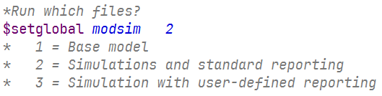
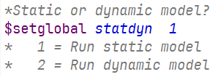
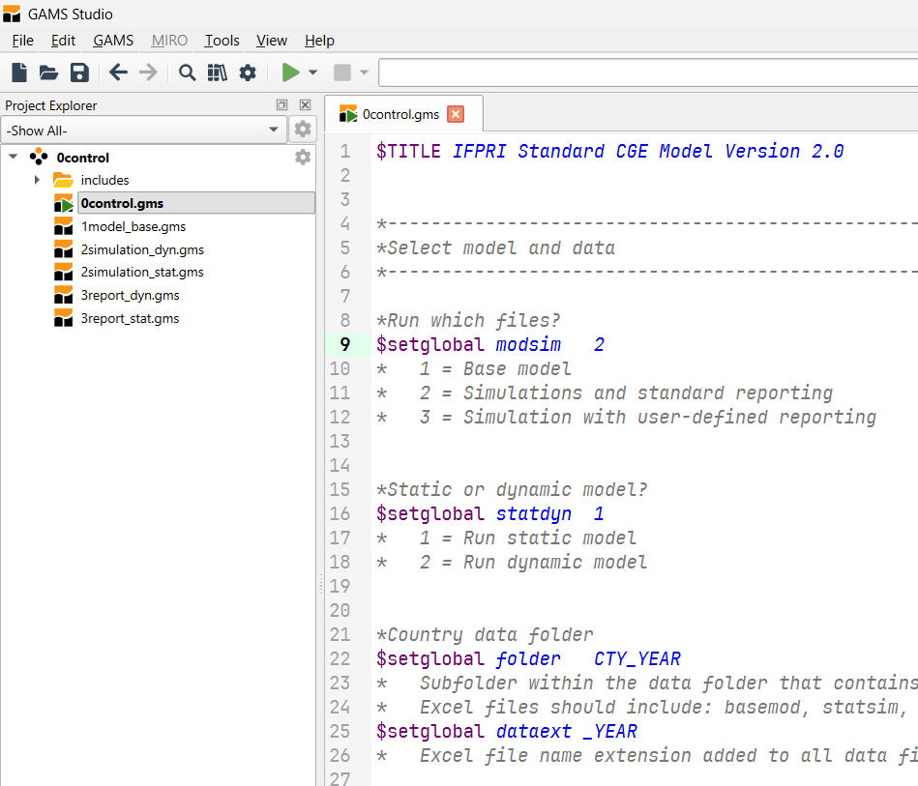
Files in the Folder _{(using GAMS Studio)}
Model Control
0control.gms
1
Model Data
basemod.xlsx
Model Code
1model.gms
2
Simulation Data
dynsim.xlsx
Simulation Code
2simulation_dyn.gms
3
Results File
dynrep.xlsx

Slide 63
Detailed File Structure
0Control.gms
MODSIM = 1
Only run base model
base_data.inc
base_calibration.inc
base_report.inc
[basemod.xlsx]
1model_base.gms
MODSIM = 2
Run base model
+ Simulations
+ Standard reporting
STATDYN = 1
Run static model
STATDYN = 2
Run dynamic model
2simulation_stat.gms
OR
2simulation_dyn.gms
[statsim.xlsx]
[dynsim.xlsx]
stat_shocks.inc
stat_process.inc
stat_repsetup.inc
stat_varinit.inc
stat_closures.inc
stat_reploop.inc
stat_report.inc
dyn_shocks.inc
dyn_process.inc
dyn_repsetup.inc
dyn_varinit.inc
dyn_closures.inc
dyn_reploop.inc
dyn_report.inc
MODSIM = 3
Run base model
+ Simulations
+ Standard reporting
+ User-defined reporting
[statrep.xlsx]
[dynrep.xlsx]
STATDYN = 1
Run static model
STATDYN = 2
Run dynamic model
3report_stat.gms
OR
3report_dyn.gms

Slide 64
Part 10 Introduction to Dynamic Modeling Establishing a baseline

Slide 65
Baseline | Setting Up the Baseline
Model Control
0control.gms
Step 2: Run GAMS files
1
Model Data
basemod.xlsx
Model Code
1model.gms
2
Simulation Data
dynsim.xlsx
Simulation Code
2simulation_dyn.gms
Step 1: Enter baseline parameter growth rates
3
Step 3: Review baseline growth rates
Results File
dynrep.xlsx

Slide 66
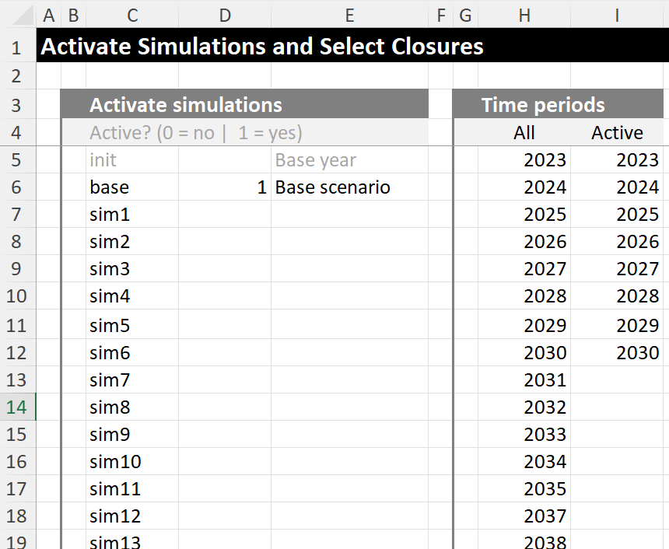
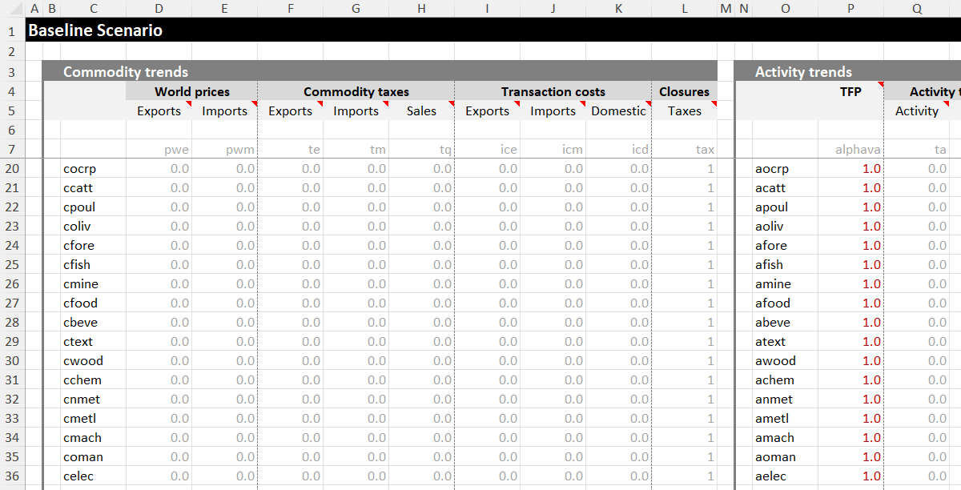

Baseline | Baseline Data Input File
dynsim.xlsx
Select active years
Enter growth parameters at detailed activity, factor and commodity levels
Main
Base

Slide 67
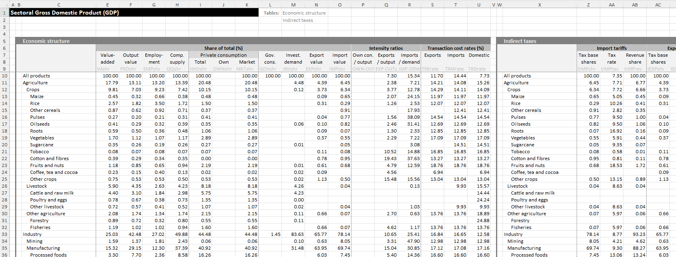
Baseline | Baseline Output File
Base year economic structure
Base year tax structure

Slide 68
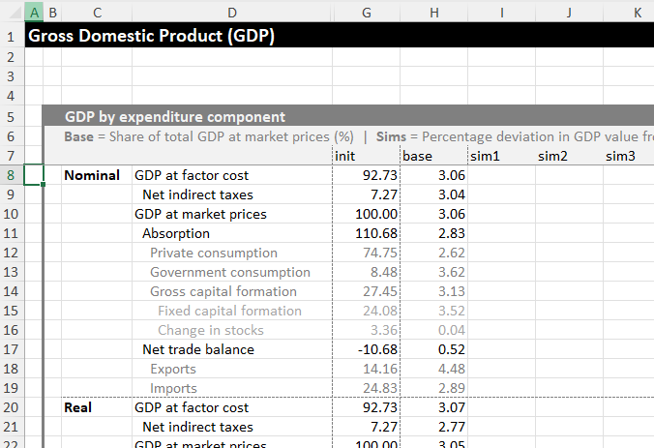
Baseline | Baseline Output File
Average annual growth rate in the baseline scenario (%)
Base year values (shares, amounts)
Deviation in annual growth rate from baseline (%-point)

Slide 69
Exercise 1 | Accelerating Baseline Growth
Task
Update the existing baseline file to accelerate national GDP growth from 3% per year to 4% per year
Closures
Savings-driven investment
Full employment for all factors
Notes
Adjust growth of demand-side GDP components to ensure “stable” or “steady state” growth path
(check investment/GDP ratio)

Slide 70
Exercise 2 | Uneven Baseline Growth
Task
Update the existing baseline file broad sectors grow at different annual rates
Agriculture = 3% per year
Industry = 5% per year
Services = 5% per year
Slow down crop land growth rate to 0.5% per year
Closures
Savings-driven investment
Full employment for all factors
Notes
Adjust growth of demand-side GDP components to ensure “stable” or “steady state” growth path
(check investment/GDP ratio)

Slide 71
Part 10 Introduction to Dynamic Modeling Designing simulations

Slide 72

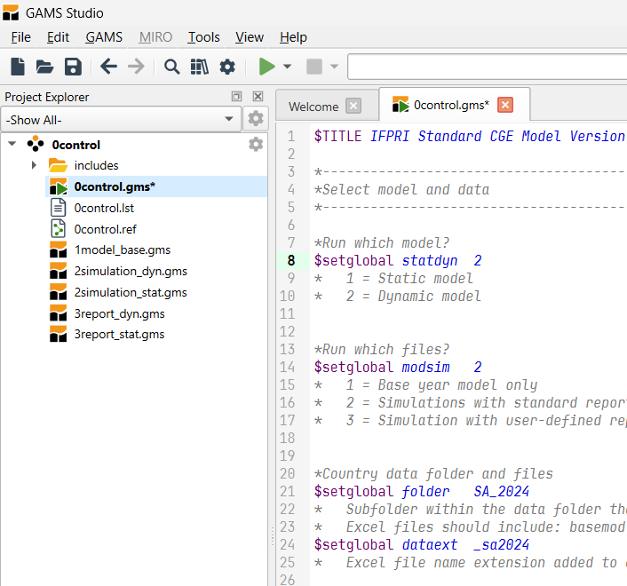
Designing Simulations
Step 2: Run GAMS files
Model Control
0control.gms
1
Model Data
basemod.xlsx
Model Code
1model.gms
2
Simulation Data
dynsim.xlsx
Simulation Code
2simulation_dyn.gms
Step 1: Enter shock parameters
3
Results File
dynrep.xlsx
Step 3: Review simulation results

Slide 73
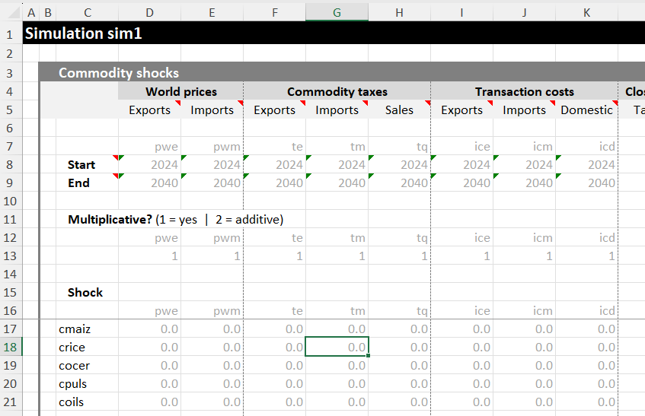
Simulations | Data Input File
Select shock period
Multiplicative or additive shock
Shock to model parameters

Slide 74
Exercise 3 | Foreign Capital Outflow
Task
Halve foreign capital inflows in 2027 (-50%).
Closures
Savings-driven investment
Full employment for all factors
Questions
What happens to investment growth and the rate of capital accumulation?
How is total GDP growth affected?
Which sectors are worst-affected by the capital outflow?

Slide 75
Part 11 Dynamic Model Exercises

Slide 76
Exercise 4 | Drought Shock
Task
Reduce agricultural TFP by 10% in 2020
Reduce electricity TFP by 25% in 2020
Standard closures
Savings-driven investment, fixed exchange rate, flexible government savings
Sector-specific capital, labor upward sloping supply curve for less educated workers (0.4 elasticity)
Simulations
Sim 1: Sector-specific land
Sim 2: Flexible land (leave crops fixed in the baseline)
Sim 3: Flexible land (above) + Subsidize electricity for consumers (negative tq)

Slide 77
Exercise 5 | Tariffs on Exports
Task
Reduce world export prices by 10% in 2020
Standard closures
Savings-driven investment, fixed exchange rate, flexible government savings
Sector-specific capital, flexible land
Simulations
Sim 1: Fully employed labor
Sim 2: Fully employed labor + Flexible land (leave crops fixed in the baseline)
Sim 3: Less educated workers unemployed (rural and urban) + Flexible land

Slide 78
Exercise 6 | Tariff Liberalization
Task
Eliminate all import tariffs (i.e., -100% in 2020)
Standard closures
Savings-driven investment, fixed exchange rate
Sector-specific capital, fully employed land
Simulations
Sim 1: Flexible government savings Labor fully employed
Sim 2: Flexible government savings Less educated workers unemployed (rural + urban)
Sim 3: Flexible direct taxes (scaled) Less educated workers unemployed (rural + urban)

Slide 79
Exercise 7 | Climate Change
Task
Reduce crop yields (-1% TFP growth per year until 2035)
Reduce hydropower production (-1% growth per year until 2025 in electricity sectors)
Reduce labor productivity (-0.25% growth per year until 2035 in agriculture and construction)
Standard closures
Savings-driven investment, fixed exchange rate
Sector-specific capital, fully employed land
Simulations
Identify 2+ policies that the government could introduce to mitigate impacts on worst affected sectors and/or households

Slide 80
Exercise 8 | Global Market Crisis
Task
Increase world food prices (+25% cereals and oilseed prices per year in 2026 and 2027)
Increase world fuel and fertilizer prices (+50% chemicals price per year in 2026 and 2027)
Standard closures
Savings-driven investment, fixed exchange rate
Sector-specific capital, fully employed land
Simulations
Identify 2+ policies that the government could introduce to mitigate impacts on worst affected sectors and/or households

Slide 81
Exercise 9 | US Import Restrictions
Task
Increase US tariff rates to 50% on all products exported to US market
Note: You need to do some background analysis to isolate US trade from trade with other countries
Standard closures
Savings-driven investment, fixed exchange rate
Sector-specific capital, fully employed land
Simulations
Retaliation: Increase own tariffs to 50% on all products imported from the US market
Identify 2+ alternative policies that the government could introduce to mitigate impacts on worst affected sectors and/or households

Slide 82
Part 12 Microsimulation Module

Slide 83
Microsimulation | Linking to Survey Households
Each household in the CGE model represents a group of individual households in the household survey (like survey weights)
[
Each CGE household is linked to its corresponding survey households
CGE household
RURAL
CGE household
Urban
Survey household 1
Survey household 5
Survey household 2
Survey household 6
Survey household 3
Survey household 7
Survey household 4
Survey household 8

Slide 84
Microsimulation | Tracking Household Level Outcomes
Pass down changes in key variables from CGE model to survey
Recalculate per capita expenditures for survey households
Some microsimulation models estimate who loses or gains a job
e.g., Occupational choice models
Some also pass information back up to the CGE model
CGE model
Employment levels
Factor incomes
Commodity prices
Consumption levels
Household survey

Slide 85
Module | Poverty and Diet Module
Outputs from the CGE model
Change in real consumption levels for each commodity group for each representative household group
Change in real commodity prices for each commodity group
Inputs in the poverty-diet module
Mapping between model and survey households/commodities (with survey weights)
Base year estimates of latent consumption levels for each commodity group for each survey household
Poverty line
Cost of a reference healthy diet (i.e., minimum consumption required in each major food group)
Outputs from the poverty-diet module
Poverty
Inequality
Undernourishment
Cost of a healthy diet
Diet quality

Slide 86
Module | Outcome Metrics
PTAB : Poverty
Poverty headcount and gap measures (i.e., rates and number of poor people)
Total consumption for each survey household is updated and compared to the poverty line
ITAB : Inequality
Thiel index
Total consumption for each survey household is updated and used to calculate index
HTAB : Undernourishment
Prevalence of undernourishment (PoU) ≈ Hunger headcount (rate and hungry people)
Consumption by food group is converted to calories and compared to FAO’s minimum daily calorie requirement
CTAB : Cost of a healthy diet
Real cost of a healthy reference diet (total and by major food group)
DTAB : Diet quality
Reference Diet Deprivation (ReDD) index

Slide 87
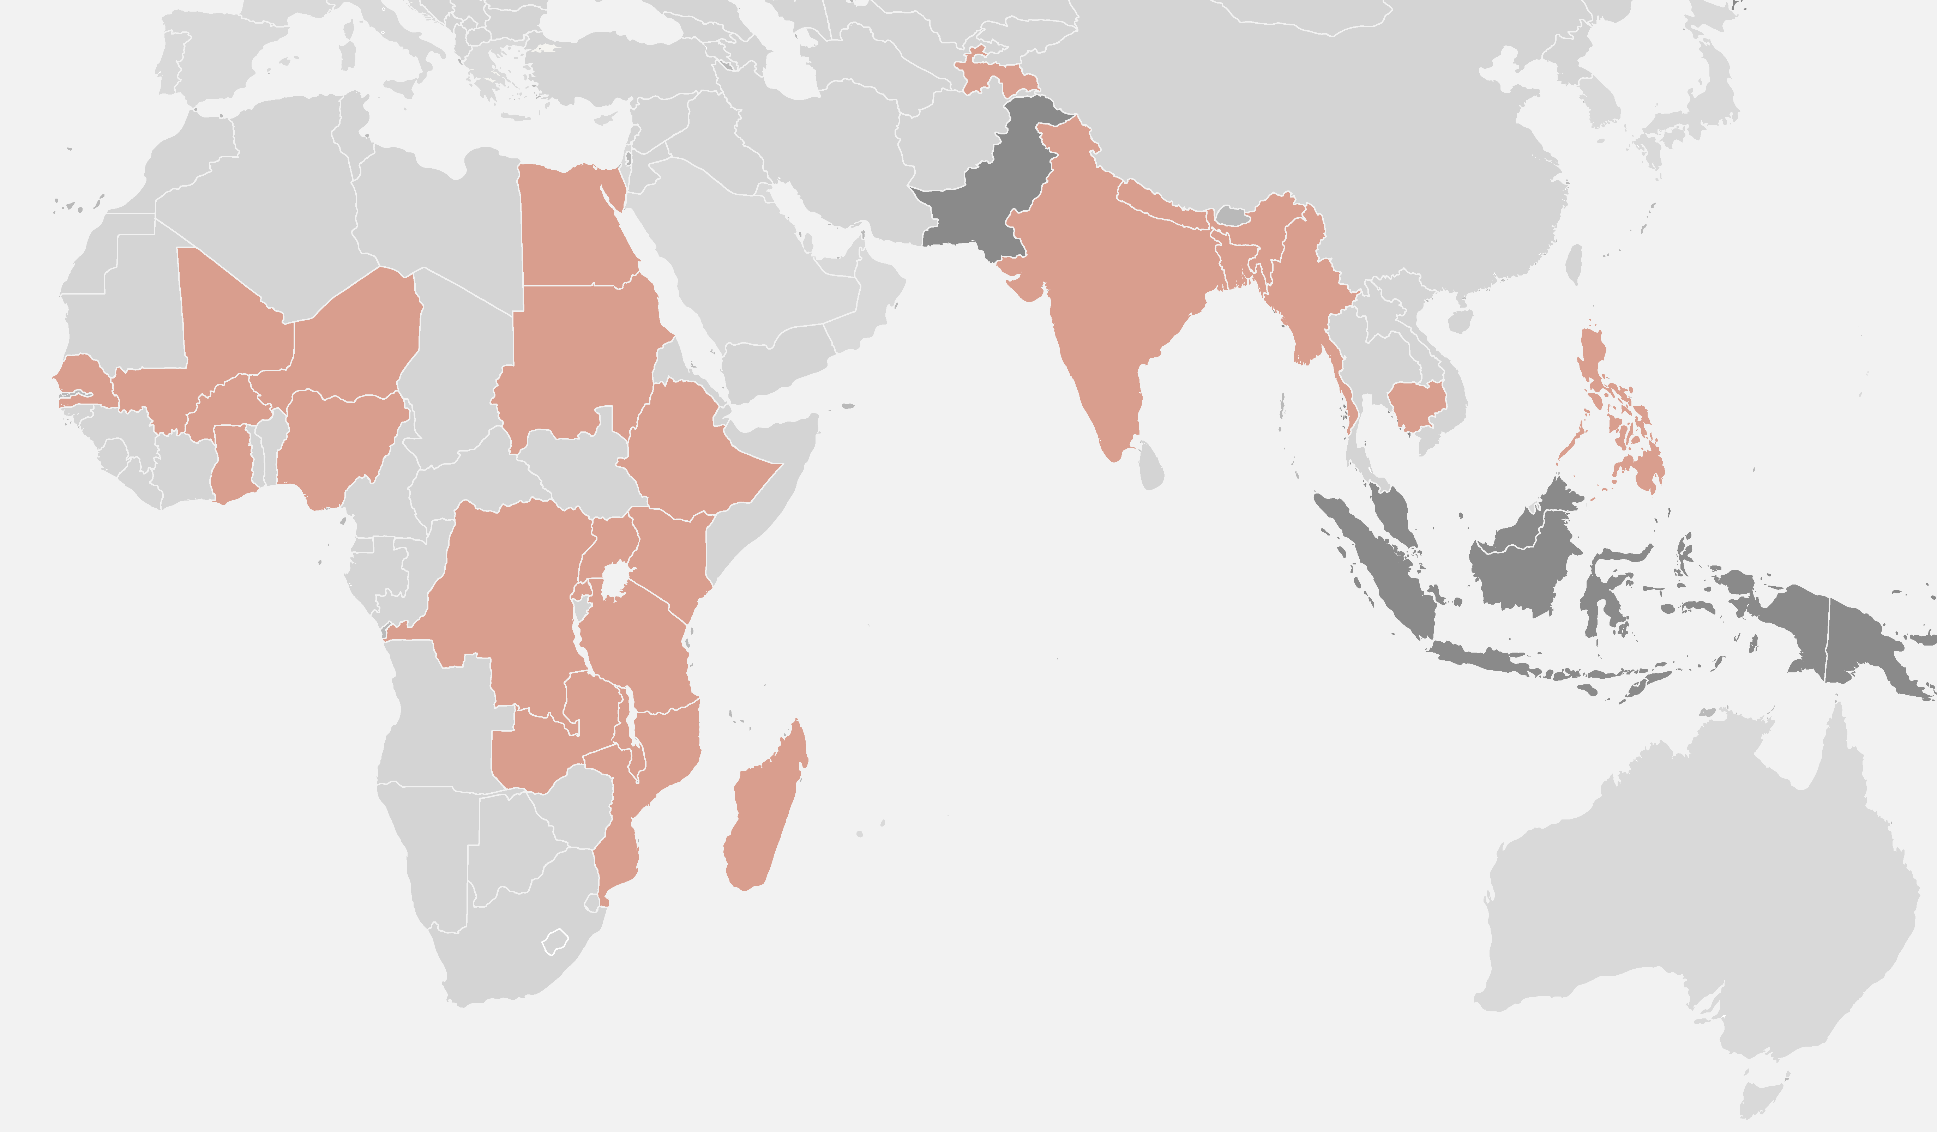
Module | Tracking Diet Costs and Quality
Factoring diets into decision-making
ReDD | Reference Diet Deprivation Index
Should consider dietary change alongside poverty, jobs and other policy goals
In addition to consumer preferences, diet quality depends on the availability, cost, and affordability of healthy foods
RIAPA is a model that tracks both product markets/prices and household incomes
ReDD index is a gap measure: tracks how far consumption levels are from a healthy diet, rather than just counting deprived people
ReDD can be tracked over time using household surveys (not only used in models)
Economywide model
RIAPA
Price changes
National ReDD indices
Deprivation gap decomposed by major food group
Consumption amounts
CoRD
EAT-Lancet
WB ICP
Cost of Reference Diet
2016/17
2015/16
2014/15
2011/12
2016/17
ReDD
LSMS
ReDD is a compound deprivation measure
Incidence Share of pop. deprived in at least one food group
Breadth Number of food groups households are deprived in
Depth Average six of food consumption gap across groups
Diet Deprivation Index
2016/17
2015/16
2010/11
2016/17
See Pauw et al. (2022)
2014/15

